Slide 1
Lecture 04
Inspiration and problem definition protocol

Slide 2
Inspiration and problem definition protocol
Write down your idea
Make an abstract 8-up storyboard
Share your work with others: 2 minutes for each idea
Discuss each idea, build on each other: keep/throw it
Finalize one idea
Define users
Identify classes
Make sketches and storyboards
Notes:
We stick to the protocol, no matter if some groups are able to complete it or not. They may complete it later and submit in the next class.

Slide 3
1 - Write down your idea on Paper
It must be a problem description, it should not be a solution to the mentioned problem

Slide 4
1 - Write down your idea on Paper
Think whether this problem can be solved with a mobile application or not.
If yes then fine. Other wise re-think an idea in this context.

Slide 5
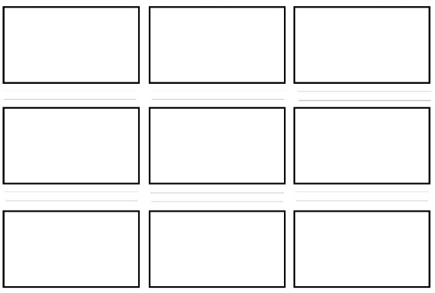
2 - Draw an 8-up storyboard
Fold a paper in half three times
Number the frames
Use each box to represent one step of your problem.
Notes:
I'm also not that good at drawing, so my sketches are very crude. But that's the point! Low-fidelity prototypes, such as sketches should be simple and easy to replicate, as well as translate and flow ideas easily into the audience.

Slide 6
A Story board
Just do a dirty quick prototype of your problem
The sketches need not be neat and clean
You can leave a comment on the back of each frame to give more context.
You can also show a character’s thinking with thought bubbles
Notes:
Story board is scenario based and is in sequence. Sketching is mostly used for designing user interface , it is stand alone and not part of a series. It contains all possible details.

Slide 7
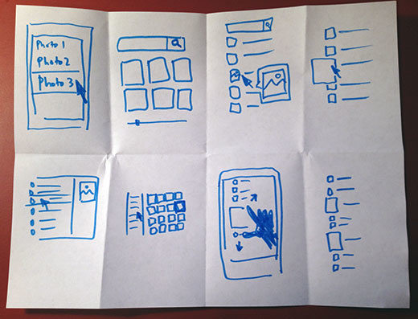
A Storyboard

Slide 8
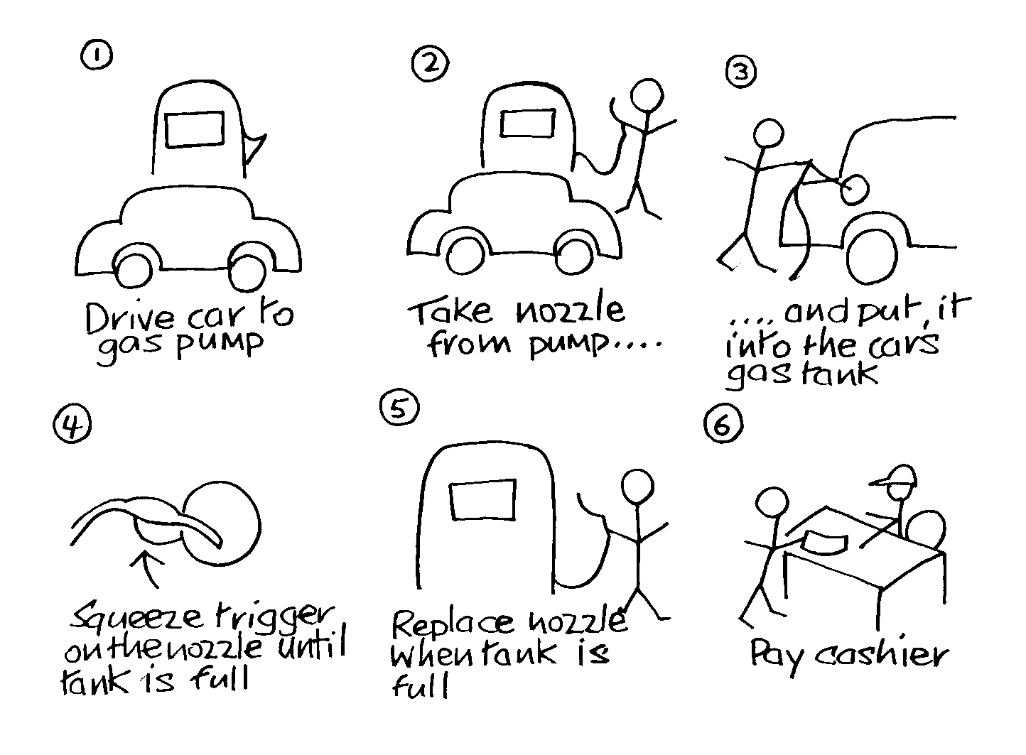
A Storyboard

Slide 9
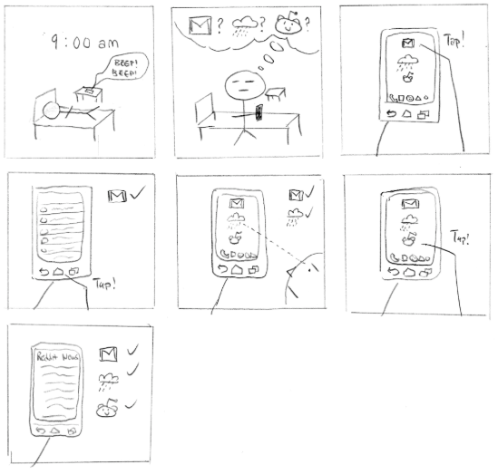
A Storyboard
Notes:
The first storyboard shows a stick figure waking up by it's alarm clock. His goal is to navigate across the three application and widget that he routinely visits every time in the morning. I don't think I see any problem at all here

Slide 10
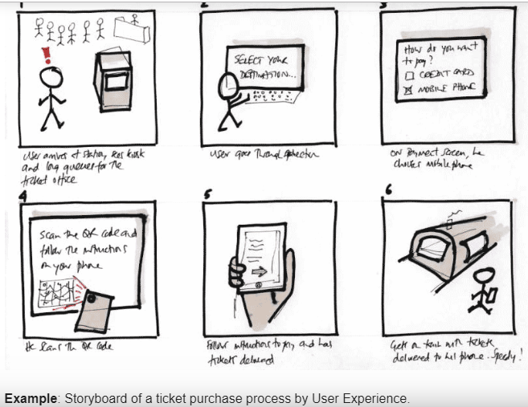
A Storyboard

Slide 11
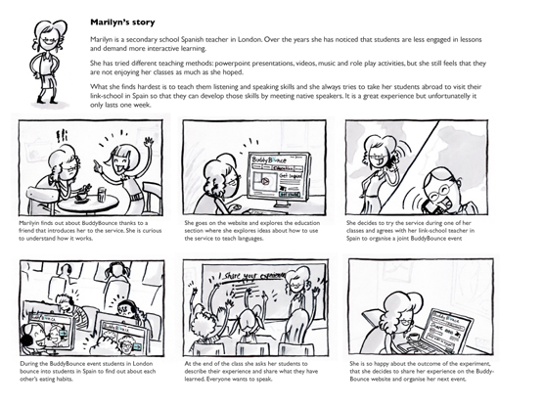
A Storyboard

Slide 12
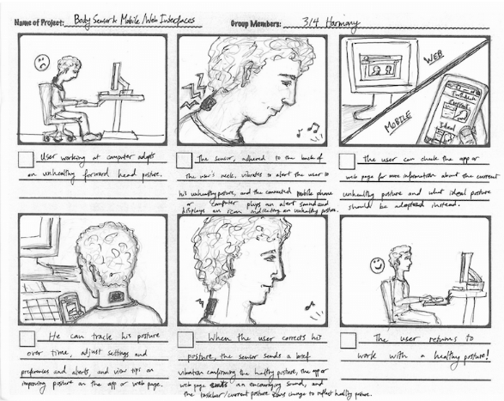
A Storyboard

Slide 13
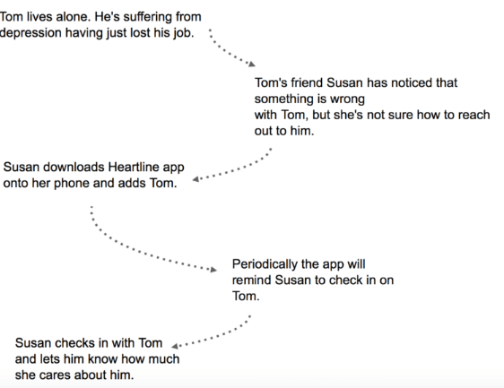
A Story board
Grab a pen and paper.
Start with a plain text and arrows.
Use proper nouns. (No common Nouns)

Slide 14
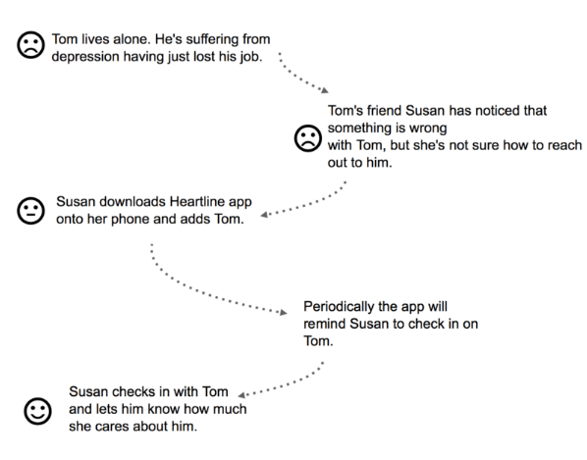
A Story board
Bake emotions into
the story.

Slide 15
Some example problems
Finding the glasses
Finding a particular blood-group donner in another city

Slide 16
3 - Share your work with others
2 minutes for each problem
Is the application that you would make to solve this problem novel?
Is it meaningful?
How it is being done now?

Slide 17
4 - Discuss each idea
build on each other: keep/throw it
You can also come up with new ideas
all ideas are equal
record everything
minimize interruptions & stay focused on topic
make it fun/rewarding
wild & wacky ideas are encouraged

Slide 18
5 - Finalize one idea
Get your group’s opinion about it
Give positive and negative feedback
Give possible suggestions and recommendations
Provide attributes for acceptance and rejection.

Slide 19
6 - Define Target Market
Discuss with each other
Shall be all-inclusive and Shall exclude areas which are not desired
Do not focus on only the “best” or most experienced users. Instead consider a range of users to ensure that your product works for at least 80% of your user population.
However, it is not impracticable to target 90–95% of the population.

Slide 20
Target Market
A particular group of consumers at which a product or service is aimed.
They have certain characteristics as demographics or psychological and behavioral patterns.
"schools are a key target market for the educational apps"

Slide 21
Target Market
Example:
McDonald’s targets students, employees, and professionals in the age group of 8 to 45 years belonging to low & middle-income groups and having an easy-going and careless personality

Slide 22
Target market
Age – What is the general age range of your current customers?
Gender – Are your current customers mostly male or female?
Income – How much money do your customers have to spend on your products or services? Are they able to make repeat purchases or do they need to save up for your product?
Location – Where do your customers live and what time zone are they in? What are some cultural issues that are unique to their location
Behavior – How do your customers hang out online? Which pages or brands do they follow and what is their preferred social media platform?
Lifestyle – How do your customers spend their free time?
Values – What are their general beliefs and values
Notes:
Age – What is the general age range of your current customers? Knowing this data will help you when choosing your target segment in social media ads.
Gender – Are your current customers mostly male or female? This will help you better understand their specific needs and wants that are perhaps unique to their gender.
Income – How much money do your customers have to spend on your products or services? Are they able to make repeat purchases or do they need to save up for your product? Are there any financial barriers that you need to address?
Location – Where do your customers live and what time zone are they in? What are some cultural issues that are unique to their location (ie products targeting American football versus real football
Behavior – How do your customers hang out online? Which pages or brands do they follow and what is their preferred social media platform? What kinds of content do they consume and can you incorporate that into your content marketing strategy?
Lifestyle – How do your customers spend their free time? What kinds of products or services do they need to support those hobbies?
Values – What are their general beliefs and values? Does this influence their brand loyalty, where they purchase products or what kinds of products they purchase

Slide 23
Preliminary Target Market Analysis
Who: Start with questioning yourself about who is going to buy your product. Are they children, teens, millennials, or baby boomers? Are they males or females? Are they service classed or self-employed? What’s their yearly income?
What: What type of products and services do they buy now and what do they expect from it? Does your product fits their requirements?
When: When do they buy the product? Is it daily or rarely? When do they use the product?
Where: Where do they live? Where do they use the product?
Why: Do they buy it because it’s their need, or is it a luxury product for them?

Slide 24
7- Identify classes
Discuss with each other
Identify User Classes
Be careful while identifying the classes, don’t include unnecessary classes

Slide 25
User Classification
There are 3 main types of user
Novice
Knowledgeable / intermittent user/ Casual user
Expert / frequent user
Users can however, be classified in any other way that is appropriate to the system being built. (user classes)
Some users may have keyboard skills, others not.
Some users may have knowledge of other similar systems, others not.
Notes:
User classes will differ based on the type of software you are writing, and the audience it is designed for. For example, I created a database application which had two user classes: traders and administrators.

Slide 26
User Classes
What will be user classes for UCP portal ?
What will be user classes for ATM ?
What will be user classes for facebook?

Slide 27
User Classes
When two user groups are there who behave differently with the system or system behaves differently with them.

Slide 28
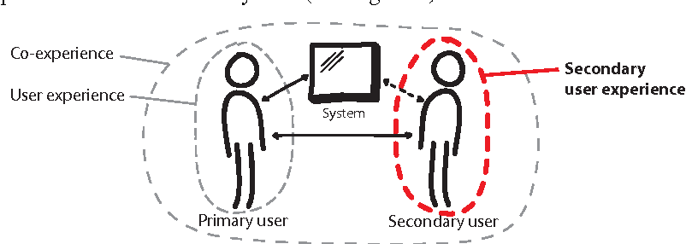
User Classification

Slide 29
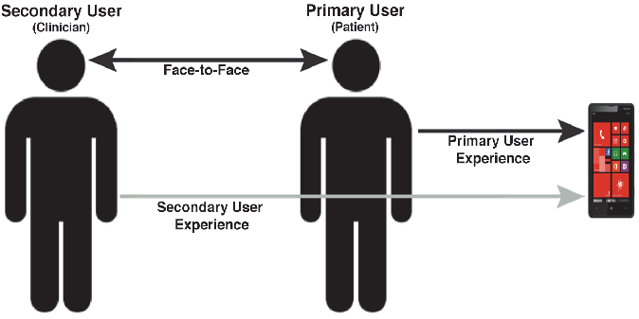
Primary/Secondary Users

Slide 30
Identify user classes
E-commerce website
Notes:
Seller & buyer, buyer-> boys and girks→ boys need efficiency and effectiveness. Girls need?? Learnability same.

Slide 31
User Classification
The advantages of classification mean that generalizations can be made about users and their needs.
This doesn’t necessarily mean that the best system has been designed for every individual.
It means that the system has been designed to fit the a user group

Slide 32
User classification
One of the advantage is at the time of installation one can set profile + no of options.

Slide 33
8- Make sketches and storyboards
Brainstorm and gradually build the idea
Write story boards and make sketches for the finalized idea

Slide 34
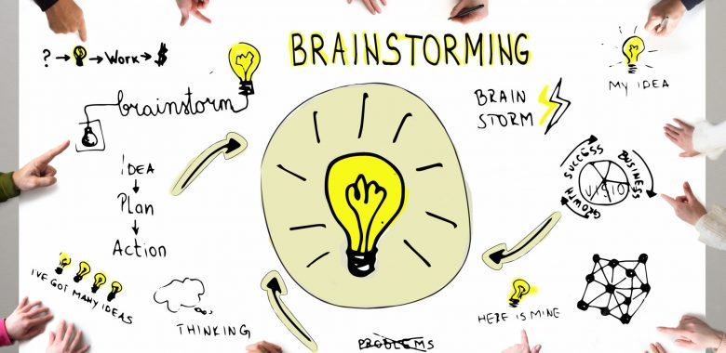
What we just did is Brainstorming
Brainstorming
  any group activity involving the pursuit of new ideas
  a technique used to generate numerous ideas using the composite talent and experience of a group in a facilitated meeting environment.

Slide 35
What we just did is Brainstorming
When it is Needed?
  increase the volume of possible ideas
  used for many things including
    names for products
    features for the next release of a product,
    possible solutions to difficult situations & issues
    goal generation for the team

Slide 36
What we just did is Brainstorming
Participants Needed
  A facilitator
  Several participants - normally 3 or more

Slide 37
What we just did is Brainstorming
Some rules of brainstorming
  all ideas are equal
  record everything
  minimize interruptions & stay focused on topic
  make it fun/rewarding
  wild & wacky ideas are encouraged
  build on the ideas of others
  one conversation at a time
  be visual

